Slide 1

CYBER RISK ASSESSMENT TOOLKIT FOR SMES
CYBER RISK ASSESSMENT TOOLKIT FOR SMES
PRESENTED BY
TECHACE SOLUTIONS LTD
GROUP 1 - CYBERSENTINELS

Slide 2

INTRODUCTION
SMEs (Small and Medium Enterprises) are vital drivers of economic growth, employment, and innovation.
They are increasingly targeted by cyber threats due to limited resources and weaker security infrastructures.

Slide 3
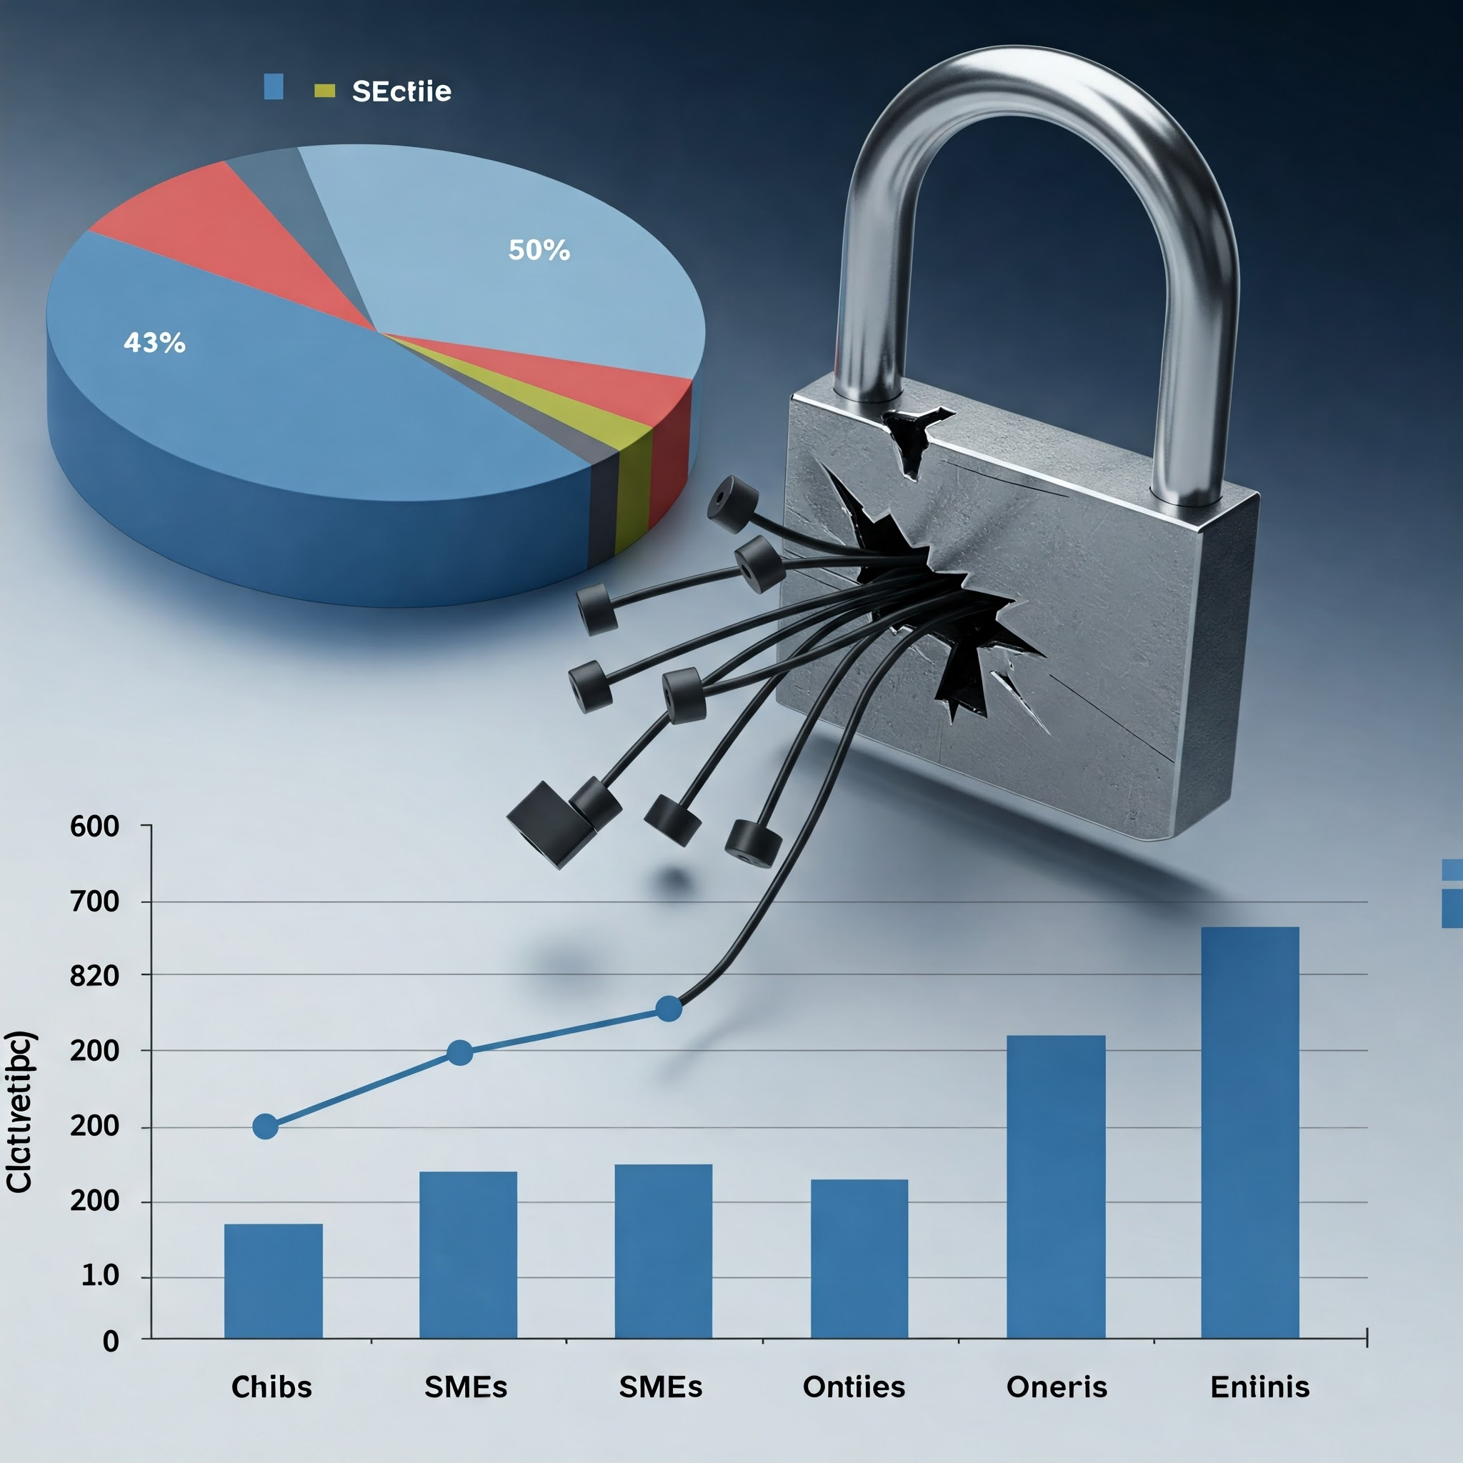
The Growing Cybersecurity Threat to SMEs
SMEs are increasingly targeted by cyberattacks.
43% of cyberattacks target small businesses.
Only 14% of small businesses are prepared to defend against cyber threats. (Cybersecurity Ventures)

Slide 4
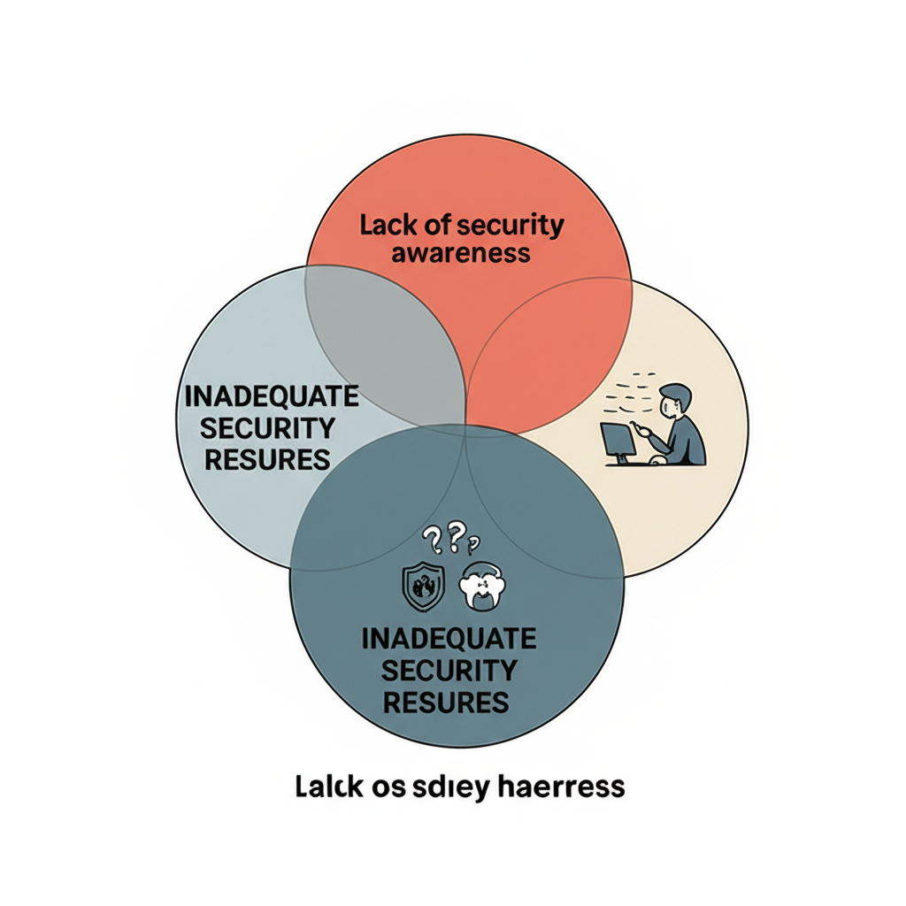
Why SMEs Are Vulnerable
Lack of awareness and training
Limited budget and resources for cybersecurity
Inadequate data protection and network security measures

Slide 5

TOOLKIT COMPONENTS
Cyber Security Awareness Guide
Risk Assessment Checklist
Cyber Risk Assessment & Incident Simulation
Cyber Hygiene Posters

Slide 6
Cybersecurity Awareness Guide Shareable pdf document containing:
Password best practice
- Use Strong Passwords: Choose passwords that are at least 12 characters long and include a mix of uppercase and lowercase letters, numbers, and special characters.
Email and Phishing Safety
- Beware of Phishing Emails: Be cautious of emails that ask for sensitive information or contain suspicious links or attachments.
Device and data protection
-Antivirus and Anti-Malware Software
-Firewalls
-Device Encryption
-Regular Patching and Updates
Remote Work Security Tips
-Secure Remote Connections
-Use Trusted Cloud Services
-Backup Data Regularly
POPIA compliance for SMEs
-Understand the Scope of POPIA
-Identify Personal Information
-Implement Data Protection Policies and Procedures
-Appoint an Information Officer
-Implement Data Security Measures
-Staff Training and Awareness
-Manage Third-Party Contracts
-Prepare for Data Subject Requests
-Prepare for Data Breaches

Slide 7
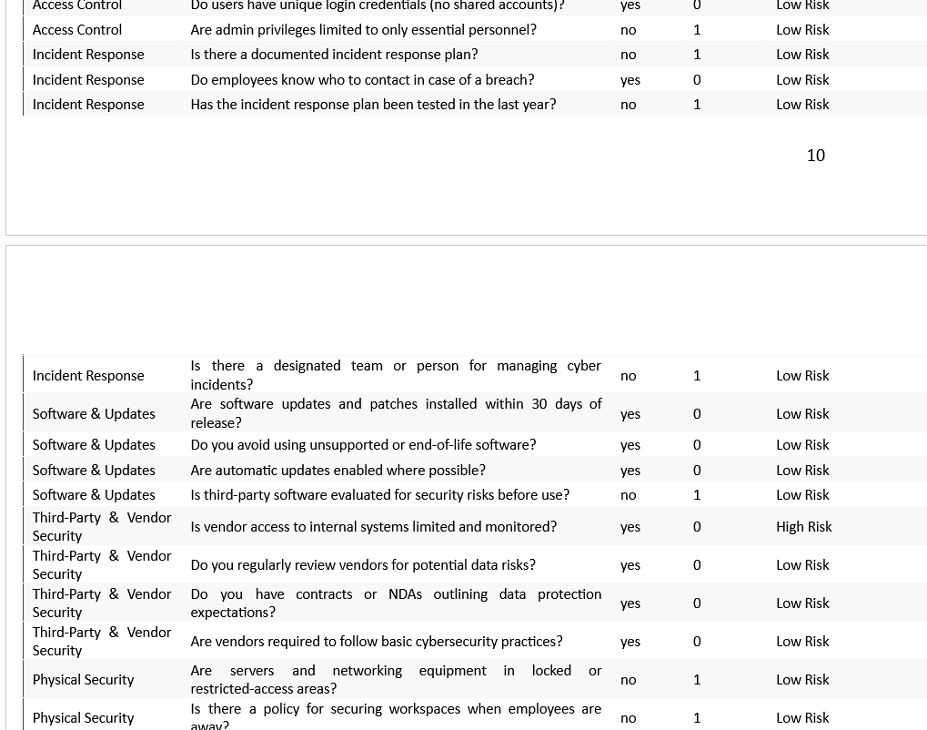
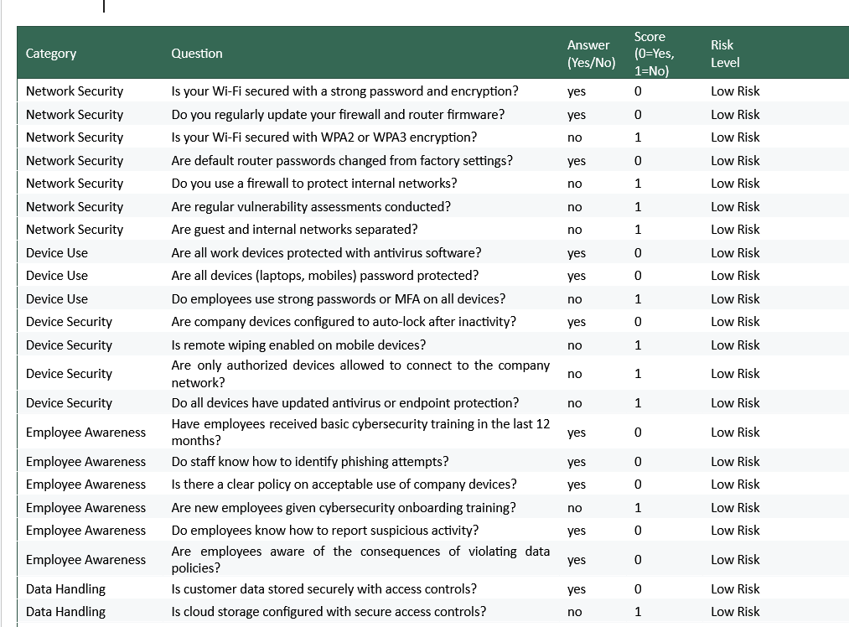
Risk Assessment Checklist Dedicated Excel sheet with various security questions

Slide 8
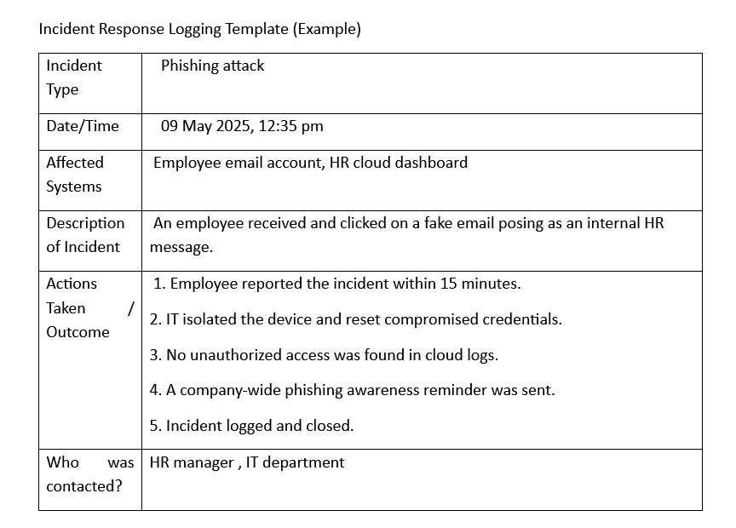
Cyber Risk Assessment and Incident Simulation A documented version of how various incidents should be handled
1. Scenario: Phishing Attack
-Employee reports a suspicious email.
-Isolate and scan the affected device.
-Check if credentials were entered—if so, reset passwords immediately.
-Report incident to IT/admin and document it.
-Educate employee with follow-up training.
2. Scenario: Ransomware Outbreak
Shut down infected devices and disconnect from the network.
Do NOT pay the ransom. Contact IT support immediately.
Check backups and initiate recovery if clean copies exist.
Document what files/systems were affected.
Update antivirus definitions and investigate root cause.

Slide 9
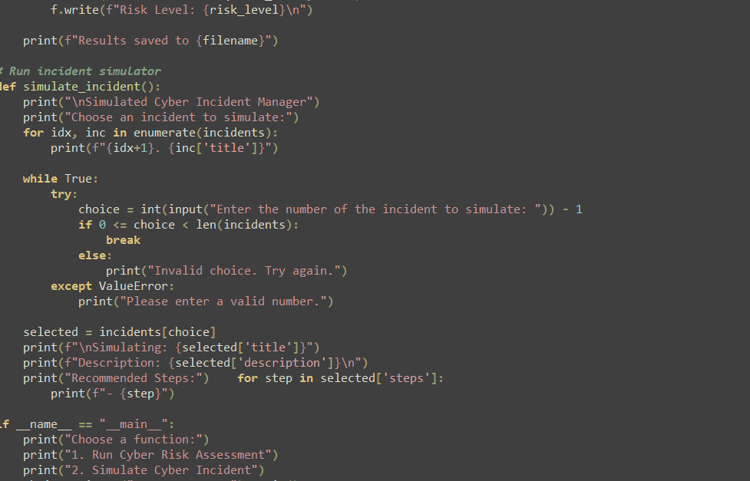
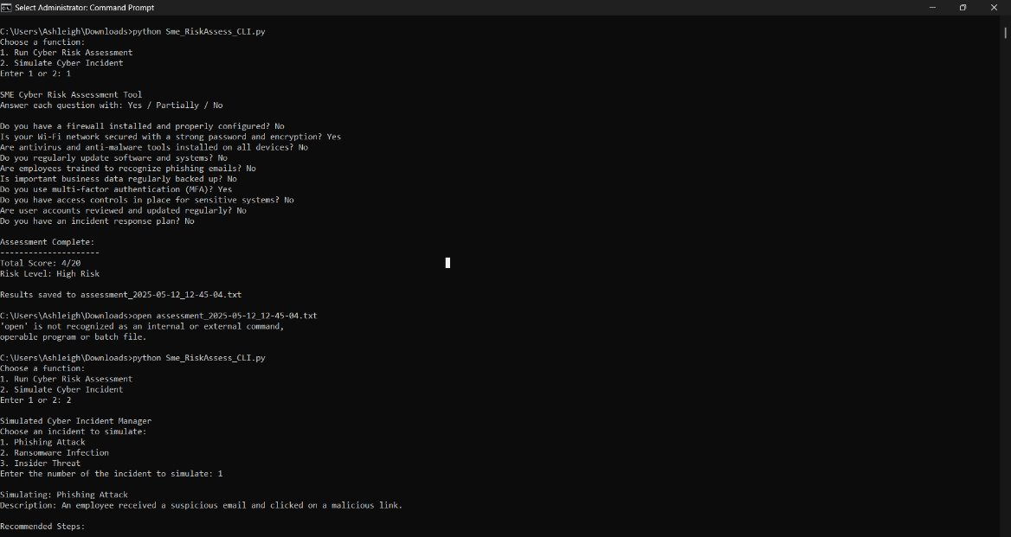
Assessment Checklist and Incident Response Simulation in code. Prototype for an automated version that can be used

Slide 10
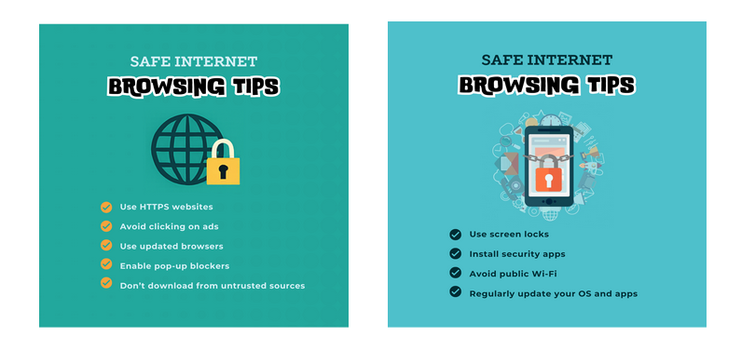
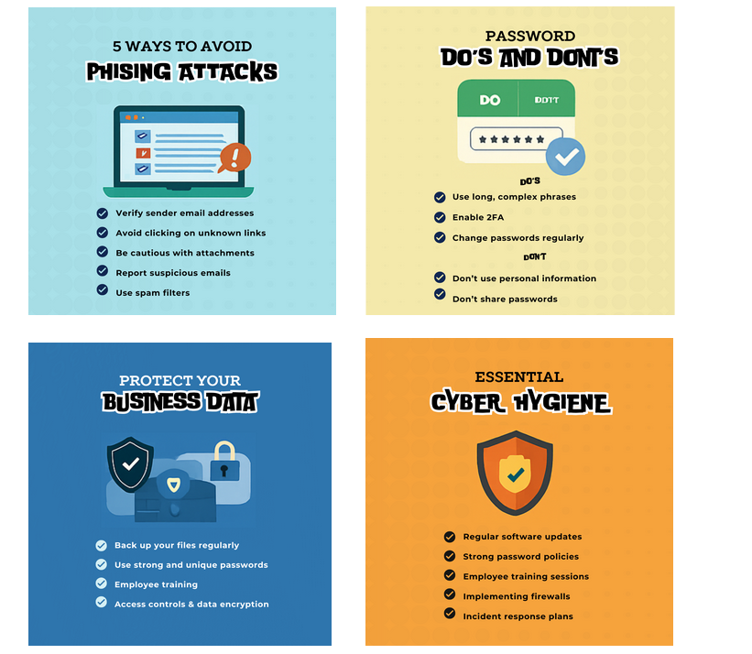
Cyber Hygiene Posters Visually appealing representations to promote Cybersecurity Awareness

Slide 11
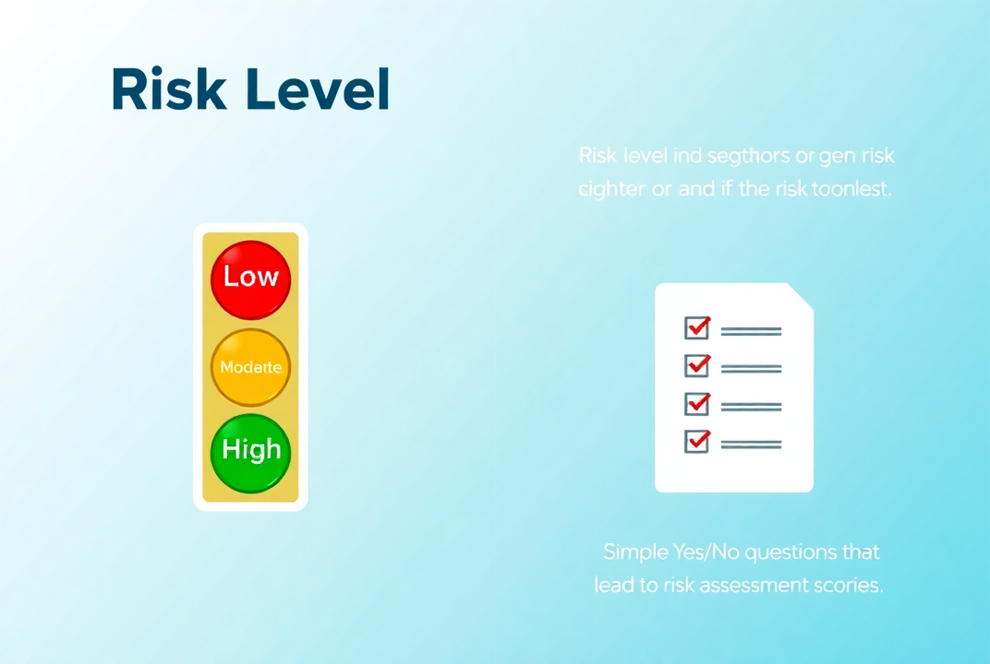
How the Toolkit Addresses the Problem
Simple and easy-to-use risk assessment
Provides an auto-scored risk level: Low, Moderate, High
Helps prioritize actions based on the risk assessment results
h.

Slide 12

How the Toolkit Helps SMEs
Affordable and scalable for businesses of all sizes
Empowers non-technical staff to identify and mitigate risks
Helps businesses maintain compliance with data protection laws like GDPR
Reduces the likelihood of data breaches and financial losses

Slide 13

Contributing to Sustainable Development Goal #8: Decent Work and Economic Growth
SDG 8: “Promote sustained, inclusive and sustainable economic growth, full and productive employment and decent work for all.”
The toolkit helps SMEs protect their businesses from cyber threats that could lead to downtime, data loss, and job cuts.
Contributes to sustained economic growth by supporting secure business operations and safeguarding employment through improved cyber resilience.

Slide 14
CONCLUSION
The Cyber Risk Assessment Toolkit for SMEs provides an accessible, affordable way for small businesses to assess and manage cyber risks.
By addressing vulnerabilities, businesses can prevent financial losses, improve their security posture, and contribute to more sustainable development.

